Slide 1



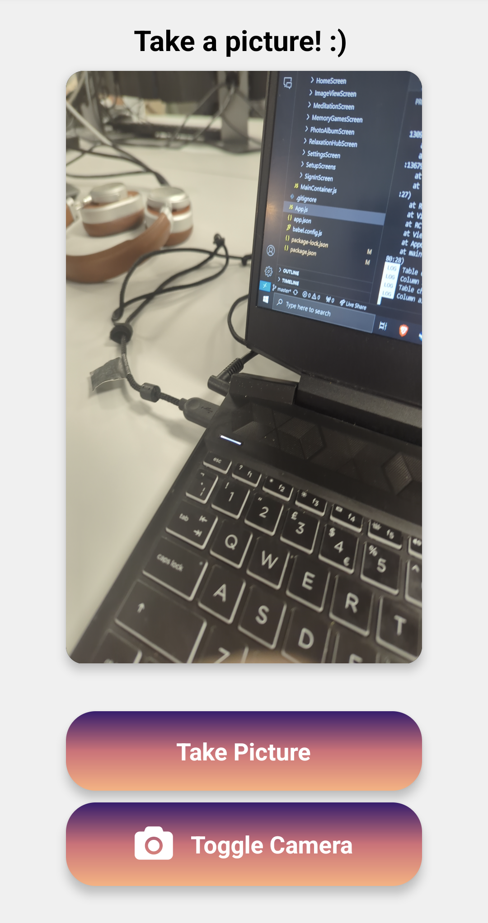
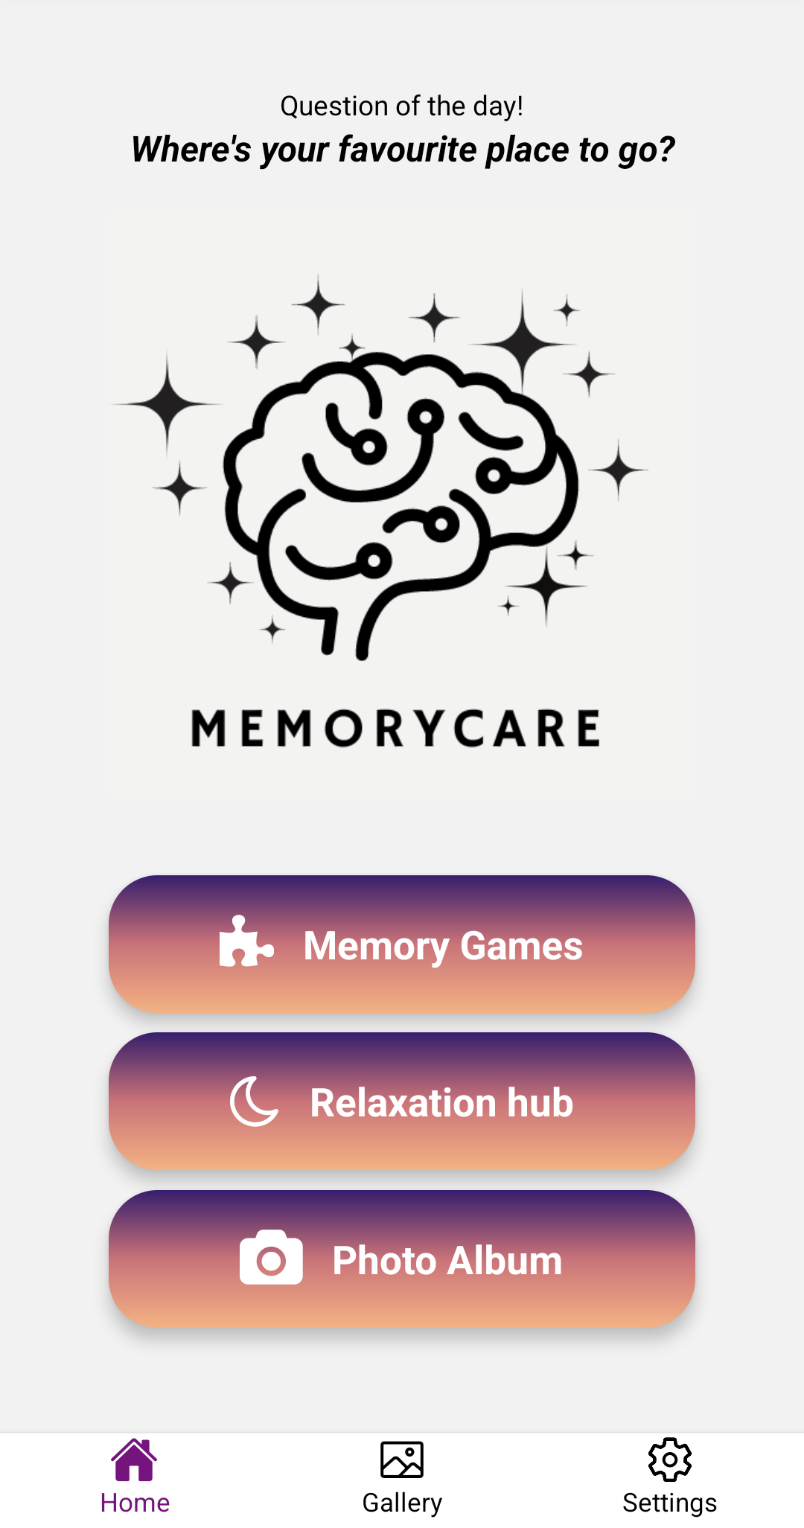
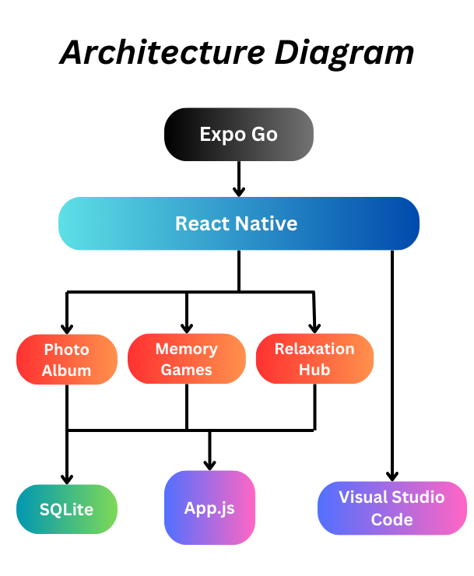
MemoryCare
Nathan Perry
BEng Software & Electronic Engineering
Description
Tailored for those navigating memory difficulties, Memorycare has a sleek, minimalist interface and features like an engaging memory game, solace in the Relaxation Hub, and a photo album that gently reminds you to capture daily snapshots along with notes. coded using JavaScript and the React Native framework, Memorycare is more than an app that supports the mind but also empowers you to preserve cherished memories and enhance cognitive wellness with ease.
Technologies
Visual studio code
JavaScript
React native framework
Expo Go
Sqlite
Features
Memory Games
Daily Photo Mode
Meditation hub
Breathing exercises

